Slide 1
Chapter 07 E7.5
By: Richard Gresham

Slide 2
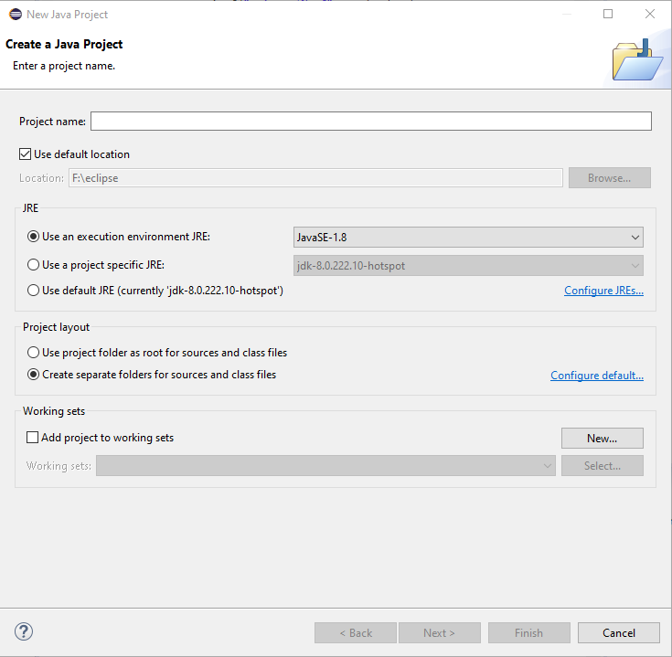
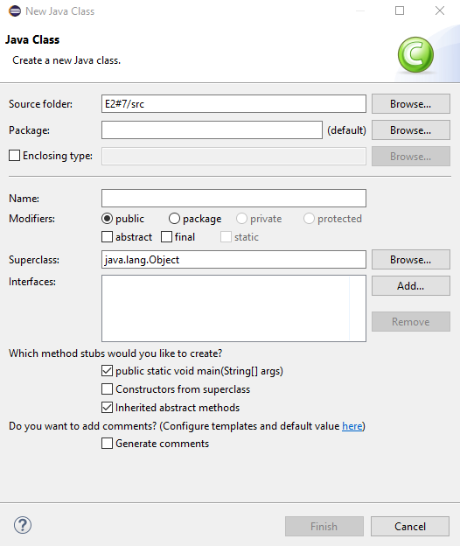
Step 1: Add anew java project/ create the class
Open Eclipse
Select File> New >
Java Project
Type in the project name
E7.5
Select Finish
Create a Class

Slide 3
Problem
Add a Method removeMin to the Student class of Section 7.4 that removes the minimum score without calling other methods.

Slide 4
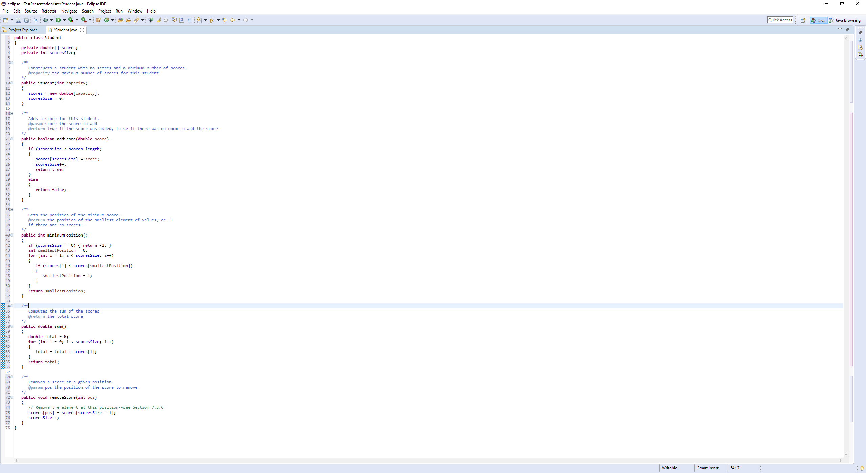
Step 2
Copy over the source code from
Book.
(go to Ch07 Reading and Study
Resources), and go into source
Files.

Slide 5
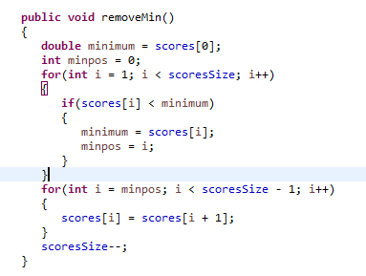
Step 3
Add the removemin() function with the steps necessary to remove the minimum.

Slide 6
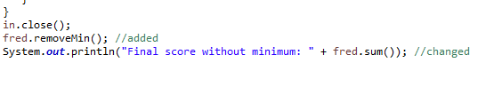
Step 4
Go to the very end of the code and make a few additions and alterations.
Add in.close(); first to prevent an error. Add the new method fred.remove();
And finally changed fred.finalScore(); to fred.sum(); which will output it correctly.

